Slide 1
Lecture 6: Datapath and Contrrol
To watch lecture video click link below
Lecture 6a video
To view slides, continue to next slide

Slide 2

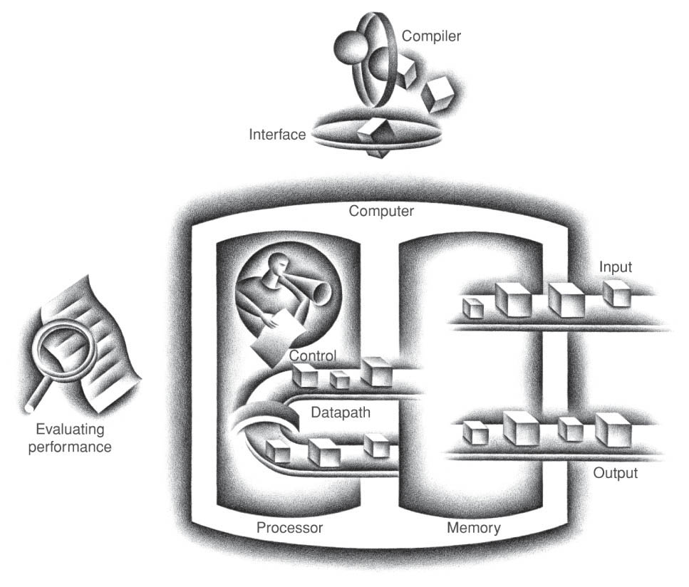
Lecture 6: Datapath and Control
This lecture covers the Processor’s Datapath and Control

Slide 3
Lecture 6a: Basics for Datapath
Introduces:
Basic implementation strategies
Functional units that are used to construct datapath

Slide 4
The Processor: Datapath & Control
We're ready to implement the MIPS ISA
Our focus: design concepts, not implementation details
The MIPS instruction set is simplified to contain only:
memory-reference instructions: lw, sw
arithmetic-logical instructions: add, sub, and, or
control flow instructions: beq
May extend to additional instructions such as addi, bne, …
A datapath is a set of functional units that carry out data processing operations
Memory, ALU, Registers, … connected together to form a datapath
A control unit directs the operation of the functional units
e.g. whether should write to memory, read from memory, or none.

Slide 5
Instruction Implementation: Basic Steps
Generic Implementation
use the program counter (PC) to supply instruction address
get the instruction from memory
read registers
use the instruction (opcode) to decide exactly what to do
add, sub, and, or, read memory, write memory, reset PC (branch), …
Functional units
PC (Program Counter): a 32-bit register that stores instruction’s address. MIPS memory address: 32-bit
Memory (here we conceptually divide a memory into IM and DM)
IM (Instruction Memory): Memory module that stores instructions
DM (Data Memory): Memory module that stores data
Registers: MIPS 32 32-bit integer registers, R0, R1, …, R31
ALU: for arithmetic/logic operations

Slide 6
General Description of Functional Units
Two types of functional units (refer to Module 4)
Elements that operate on data values (combinational)
e.g. ALU, MUX (multiplexor), …
Elements that contain state (sequential)
Those are the hard components with “memories”
e.g. flip-flops, registers, memory modules, …
State Elements are normally controlled by “clocks”
In MIPS, we use edge triggered clocking
i.e. Register/Memory write won’t occur until the end of the clock cycles
This illustrates an instruction execution starting at one state element (e.g. reading IM) and ending at another state element (e.g. writing register/DM) within one cycle.

Slide 7
Design Strategies
First design
Use a single long clock cycle
The cycle long enough for the most complicated instruction
Characteristics
Simple in design (good for teaching purpose)
Not practical due to low efficiency
Second design
Multiple clock cycles
Pipelined implementation
More practical but more complex
To be discussed in Module 7

Slide 8
Building Blocks: IM, PC, adder
IM: every cycle reads out an instruction per given address. No write action. Every cycle reads so no specific control signal needed.
PC: 32-bit register storing program counter. Every cycle read (first) and write (update PC, at end of the cycle). No control signal needed.
An adder is a simplified ALU, only able to perform addition operation. No need control, the Sum changes if inputs change.

Slide 9
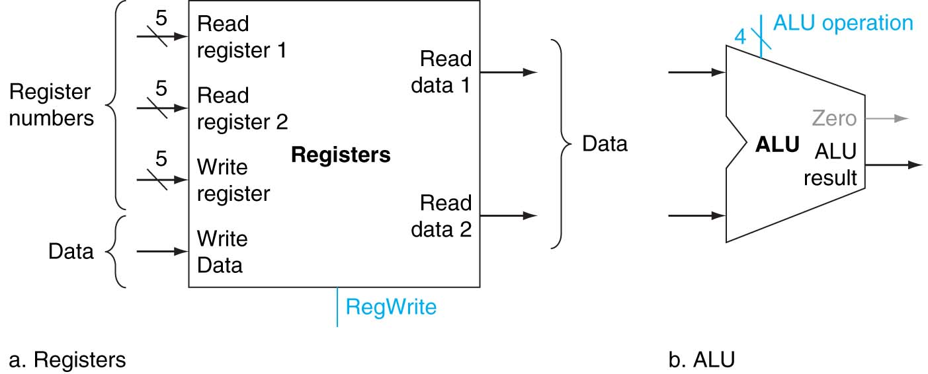
Building Blocks: Registers and ALU

Slide 10
Registers
Two read ports
Read two registers simultaneously.
Read occurs at the beginning of a clock cycle
Input for reading registers:
2 5-bit register numbers
Output from reading registers:
2 32-bit data read out from registers
One write port
Write at the end of a cycle.
Input for writing register:
5-bit register number
32-bit data
Output from writing register
No specific output
The 32-bit data is written to the reg.
e.g. reading R12, R14
Input: Read reg1: 01100 (12)
Read reg1: 01110 (14)
Output:
Read data1: 32-bit value stored in R12
Read data2: 32-bit value stored in R14

Slide 11
Registers: Control Signal
RegWrite is a control signal controlling the write operation
Read operation no need to be controlled;
Always read out
No hard to read out
If data read out unwanted, just ignore it.
Write operation must be controlled;
Cannot randomly write to a register to update the value.
RegWrite
1-bit control signal, 0 (no write), 1 (write)
Also, write occurs at the end of the cycle
e.g. add R8, R12, R8
Safe to read out R12, R8 at the beginning and then update R8 at the end.

Slide 12
ALU Control
The table above shows the 4-bit ALU control signal as listed in zyBook Ch 4.4. Since we only consider and, or, add, sub four funtions, so the table is simplified as:
ALU Control | Function
0000 | AND
0001 | OR
0010 | ADD
0110 | SUB
Note: if we ignore the first bit of ALUOp, the signal values are consistent with the Binvert and Op signals for the ALU we designed in Module 3.

Slide 13
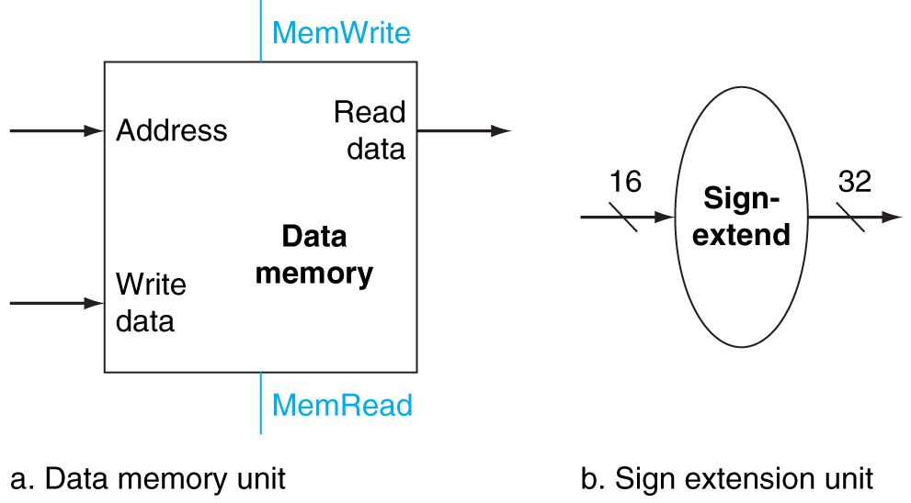
Building Blocks: DM and SE

Slide 14
DM Block Diagram
One Read Port
Input: address (32-bit)
Output: read data (32-bit)
One Write Port
Input: address (32-bit)
write data (32-bit)
Output: none (but the 32-bit write data is written to the memory location referred by the address.
Control signals
MemoryRead: 0 (no read), 1 (read)
MemoryWrite: 0 (no write), 1 (write)
Note: we do not always read memory for various reasons including use of cache (Module 8 will discuss memory catching), thus read the memory only when MemoryRead signal is set.

Slide 15
Sign Extend (SE) Block Diagram
Sign-Extend unit is to convert a 16-bit two’s complement number to 32-bit two’s complement.
For example, converting a 4-bit two’s complement number to 8 bits, we extend the first (leftmost) bit four times
0010 -> 0000 0010
1011 -> 1111 1011
Note: 1011 -> 0000 1011 is wrong
Because 1011 represents -5 while 00001011 represents +11 in decimal.

Slide 16
Datapath for Instruction Implementation
Coming up …
we will build up a datapath for each of the following instructions
Add, sub, and, or, lw, sw and beq
Then, we will connect the datapaths to form a general datapath for executing any or all of the above instructions.
We will add control signals to the datapath to form a processor.
We will trace the implementation schedule to make sure all the above instructions run well on the processor.

